Slide 1
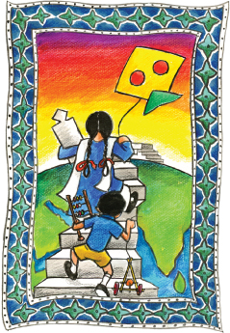
Innovations: Demand & Supply
A case of district level delivery
Children’s Global Network - Pakistan

Slide 2
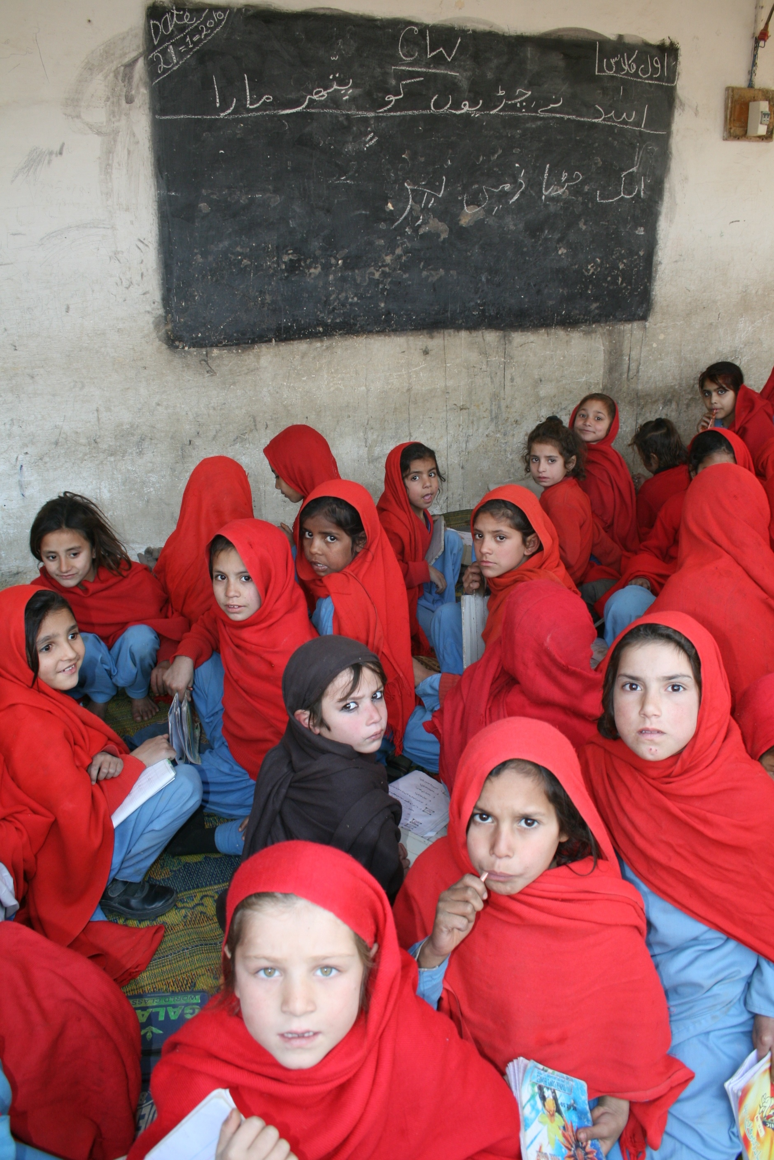
About Us
Children’s Global Network – Pakistan (CGNPK) is a non-profit organization working in the education sector since 2002 through field interventions and policy reforms to improve access to and quality of education for every child in Pakistan.

Slide 3
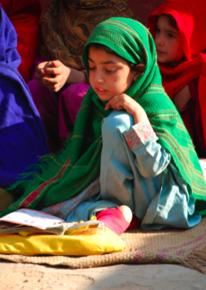
Our Research Study On ECED
To understand how ECED is practiced in the public and private education sectors in rural and urban areas in districts Vehari, Multan and Muzaffargarh.
To study impact of decade long interventions of various organizations including CGNP in the above mentioned target areas.

Slide 4
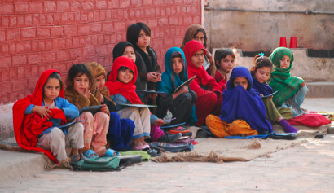
About the Study
Objective:
To develop a clear understanding of the care, development and education that children undergo from birth till the age of six in the target areas of districts Multan, Vehari and Muzaffargarh

Slide 5
About The Study continued……
The study was conducted in two parts:
A series of discussions with teachers, parents and knowledgeable people in communities to gain understanding of prevalent issues in ECED.
Survey of ECED centers and schools to quantify problems in target areas.

Slide 6
About The Study Continued……
Study Sample
5-7 localities in each of the three districts( 317 schools in 79 villages) were identified where organizations including CGN-P were already conducting ECCD interventions:
Vehari
187 EB in Burewala tehsil
8 WB in Vehari tehsil
Nur Shah in Melsi tehsil
Gujjarwala in Burewala tehsil
Muddi Behni in Melsi tehsil
UC 911 in Vehari tehsil

Slide 7
Sample For The Study continued…..
Muzaffargarh
Maqwal Haider in Alipur tehsil
Subhai Wala and Rampur in Jatoi tehsil
Morian in Kot Addu tehsil
Fatehpur Janobi in Alipur Tehsil
Munha in Kot Addu tehsil
Taliri in Muzaffargarh tehsil
Multan
Basti Hamrot and Cherry Tree School,
Nishtar Colony and Jinnah Town,
Basti Mithu and Gulu Wala, Shujaabad
Ahmadabad
Shah Gardez,
Jalalpur Pirwala city and tehsil, Multan

Slide 8
Set-ups Offering ECCD in the Target Areas
Government Schools
Private Schools
NGO-funded ECCD Centers
Madrassahs

Slide 9
Findings of the study
Public Private Schools
Public and Private Schools Outnumber NGO Sponsored Schools. Almost 96% were either government or privately owned.
Government Schools are Well Situated in Each Village. Only 3 (4%) of all villages lack a government school, while 34 (43%) of villages do not have any private schools.
Private Schools are Relatively New to the Market: Almost 94% of public schools were established more than 10 years ago, while only 37% of the private schools are at least ten years old
Private Schools are Better Staffed. More than half of the private schools in our sample have 6 teachers or more while only a quarter of the public schools have 6 teaches or more.
More private schools offer ECCD than public schools with high enrollment in play group and nursery.

Slide 10
Findings of the study continued……..
Nutrition
Most parents approve of breastfeeding their children till 2 years of age
Most parents integrate children into family meals from 3-6 years
Parents often discourage children from eating unhealthy food although they have little awareness about healthy food
Limited awareness amongst parents and children about diet and immunization
Failure to monitor children's diet and sanitation
Very little religious resistance to health interventions
Lack of health facilities

Slide 11
Findings of the study Continued…….
Immunization
Most schools provide polio drops on a regular basis
Health teams sometime visit as part of health campaigns for polio, dengue, and tetanus:
87% of all schools had been visited by a vaccination team at least once
while 13% had not received a single visit.
The median number of visits per school was three.
There is an awareness about immunization, but less information on why they are important
Diseases and serious illnesses are still common among children:
Flu was cited by more than 90% of all schools as a common problem.
A little more than half reported that typhoid was common (52%). Other health problems included stomach issues (39%), skin disease (39%) and asthma (31%).

Slide 12
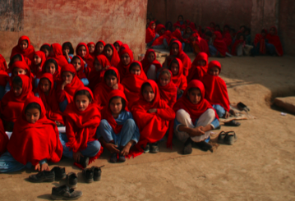
Findings of the study continued…….
Education:
Average enrollment age for kachi is 4.7 years which indicates a strong need for ECCD.
Most schools believe the syllabus is inadequate:
about two-thirds believed syllabus is too difficult
Many Children are Expected to Drop Out Throughout Primary School:
about 10-15% of children are expected to drop out before or during Grade 1

Slide 13
Problems with ECCD
Unregistered children and rolling admission policies cause children of different age groups to be grouped in any single classroom posing administrative and quality problems.
Lack of constitutional recognition prevents ECCD from Receiving Attention:
constitution currently only recognizes education for children between 5 and 16 years old
Lack of ECCD programs. Most private schools have ECCD programs while not the public schools.
Lack of awareness/involvement among parents in matters of health and education.
English as the Medium of Instruction impedes learning in multilingual settings
Parents' financial difficulty diverts admissions towards unregulated madaris
Farming seasons also affects attendance levels.

Slide 14
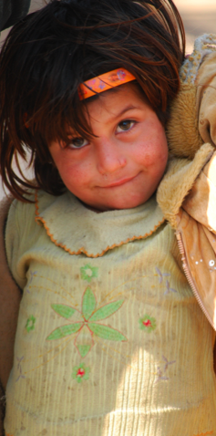
Taking ECCD Forward
Government initiative:
Must grant constitutional/policy recognition to needs of children under 5 years old
Must create policy to address the overcrowded classrooms, long distances to schools and poor facilities
Must provide support to schools and their facilities for health and education both
Must create awareness among parents of children in this age group
Must encourage district, provincial and national level research on ECCD needs and potential

Slide 15
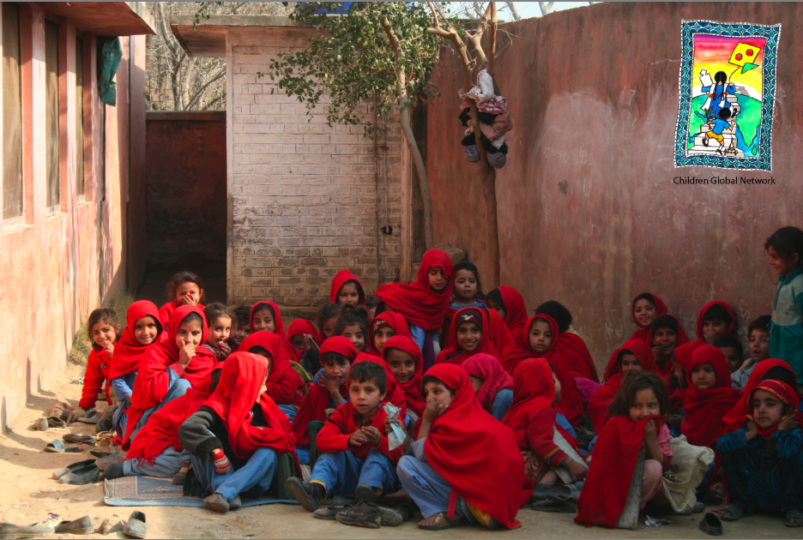
Thank You………………….

